Slide 1
Girlfriends of Largo
WHO Lady Tigers who would benefit from positive role models and serving as positive role models to others in our school and community
WHAT Meetings include service projects, goal setting, guest speakers, and special events
WHERE Meet in the cafeteria at the Girlfriends table
WHEN Mondays during ELP from 4:15-5:15
WHY Every girl needs girlfriends on her team
HOW Talk to Ms. Gomez in C7 or Mrs. Edwards in Pod 7 or pick up an application in the offices
Mission Statement To create a supportive environment with positive role models for young ladies to excel in academics, display positive behaviors, maintain high self-esteem and demonstrate leadership skills.
Notes:
Each slide from here on out will describe clubs or groups on campus. Contact for girlfriends is Mrs. Edwards Pod 7 or Ms. Gomez C7.

Slide 2
WHO Anyone that wants to have a leadership role with a diverse group of other tigers and make change to our school culture.
WHAT Meetings include service projects and special events
WHERE Meet in the Media Center
WHEN Last Friday of Every month 9-9:35 AM
WHY Our school values your input
HOW Talk to Mr. Jordan in B4 for more information

Slide 3
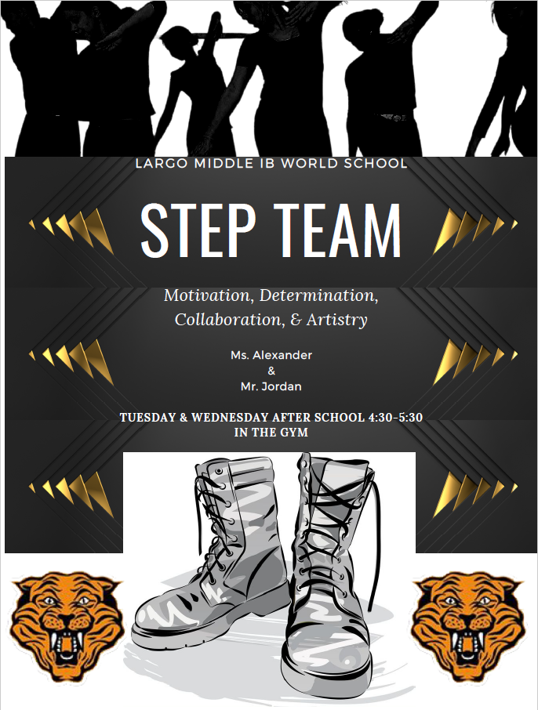
WHO Anyone that wants to creatively express themselves through dance sharing motivation, determination, collaboration and artistry.
WHAT Meetings include creating and performing Step routines
WHERE Meet in the Gym
WHEN Tuesday and Wednesday 4:30 pm-5:30 pm
WHY To be creative and engaged in something
HOW Talk to Mr. Jordan in B4 or Ms. Alexander in the 8th grade house for more information

Slide 4
WHEN? TIME: During 3rd Lunch DAY: To Be Determined
VISION:
SAVE (Students Against Violence Everywhere) Promise Clubs are a place for young people across the country to show their leadership, creativity and passion for protecting their friends, schools and communities from violence BEFORE it happens.
See MS. SCOTT
in D-5 for details on how to join!

Slide 5
WHEN? TIME: During 3rd Lunch DAY: To Be Determined See MS. SCOTT in D-5 for details on how to join!
VISION:
A strengthened substance-free, healthy, and safe lifestyle for all students, schools, and communities in Pinellas County.

Slide 6
Wednesday afternoons, 4:15-5:15pm
Room E2, October 5th – April 26th
For more information, contact Mr. O’Shea (oshear@pcsb.org)

Slide 7
Largo Middle Basketball
Calling ALL Boys Hoopers!!
If you are interested in Largo Middle School Tigers basketball team, please sign the interest sheet in your grade level office. All paperwork MUST be turned in to tryout.
Looking for Championship Mindset Players!
Don’t Be Afraid To Be GREAT!!

Slide 8
Largo Middle School Flag Football
Calling ALL Flag Football Ballers!!
If you are interested in Largo Middle School Tigers Flag Football team, please sign the interest sheet in your grade level office. All paperwork MUST be turned in to tryout.
Looking for Championship Mindset Players!
Don’t Be Afraid To Be GREAT!!

Slide 9
ART CLUB Art Room F-1
Welcome to Mr. Powell’s Art Club. Every Wed. 8:20 – 9:20 & Thurs. 4:15 – 5:15
~ Drawing ~ Painting ~ Sculpture ~ Clay ~ Printmaking ~ 3D Printing
Student-centered Learning &
Make-up classwork!

Slide 10
Japan Culture Club 日本の培養クラブ
Mr. Powell ー Art room F-1
Wed. 8:20 – 9:20 & Thurs. 4:15 – 5:15
Learn about:
Japanese Culture
Interesting Japanese Places
Japanese History
Japanese Food
Japanese Language
Draw Anime/Manga
And much more…

Slide 11
WHO Service Oriented Learners
WHY To Improve our Communities
HOW Talk to Ms. Worst in chorus room for more information

Slide 12
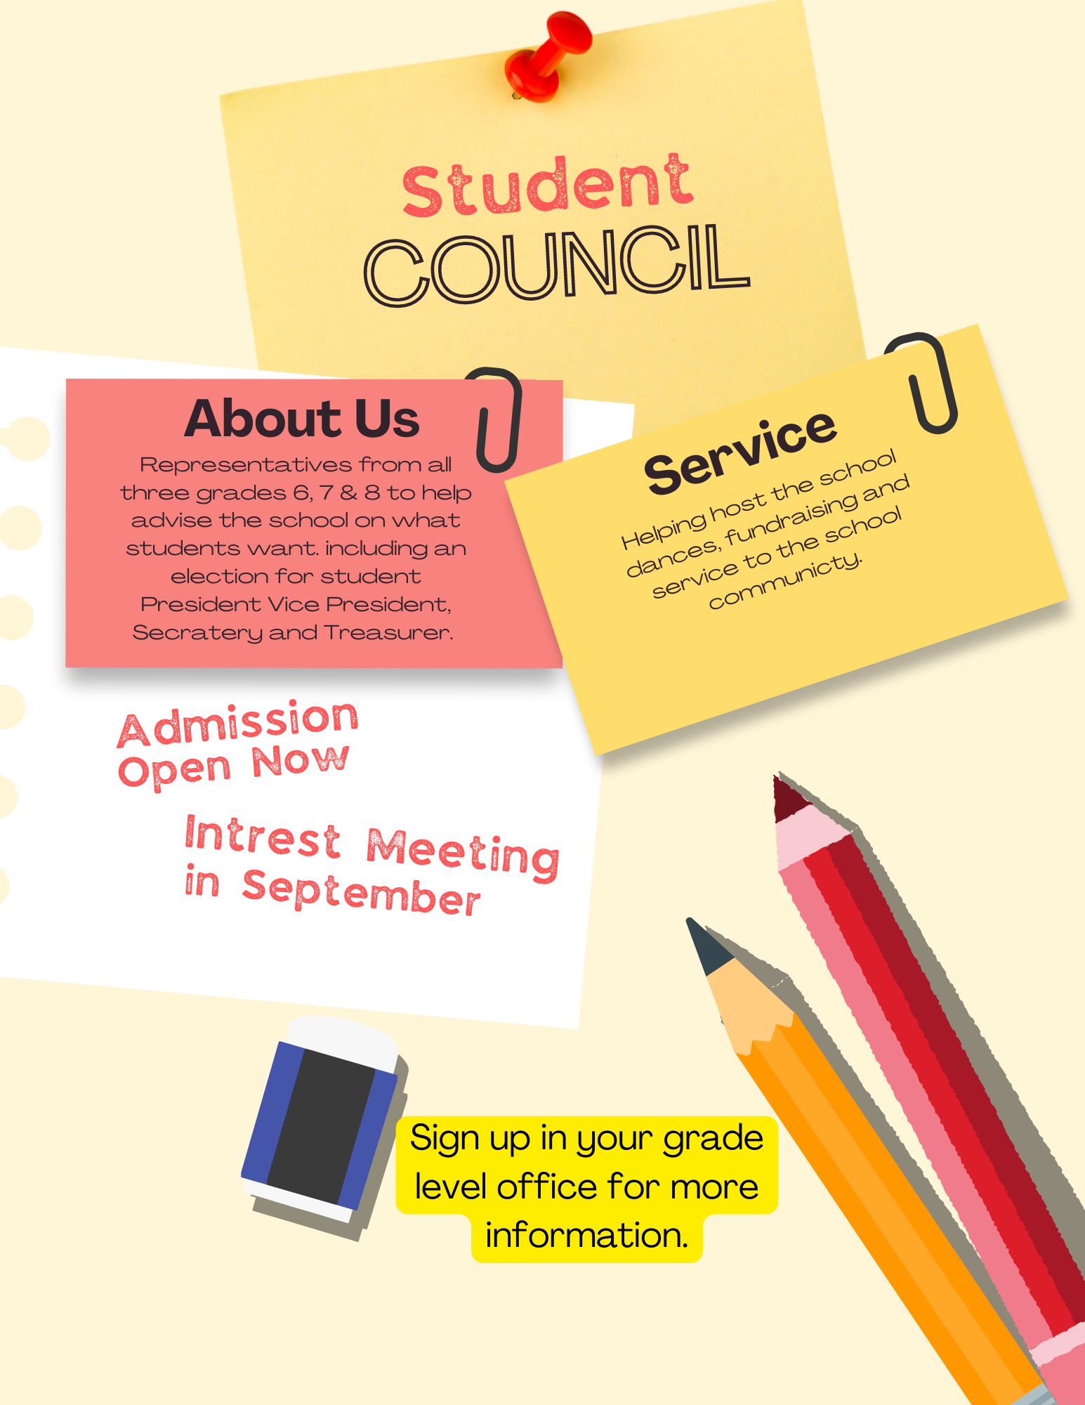
WHO Civic minded learners that want to help drive decisions for Largo
WHAT Meetings include service projects, event planning and fundraising.
WHY To share your leadership talents to make Largo Middle IB World School better for everyone
HOW Go to the grade level houses and add your name to the list, you will get notification of the interest meeting in late September.

